Slide 1
SU2 performance analyser
Vem technologies pvt., limited
ID:N120695
Project Guide:Kumar Anurupam
Company Guide:P.V.K Reddy

Slide 2
Softwares Used:
1. GUI: Python3 and Tkinter
2. SU2 libraries
3. OpenMP/MPI
4. SSH for communication.
5. Matplotlib or Paraview for plotting

Slide 3
Su2 performance analyser
Problem statement:
Solving CFD (computational fluid dynamics) problem serially is time consuming process.
Building su2 soruce code and executing cfd manually is tedious task.
1. Solve CFD with parallel computation (OpenMpi)
2. Reduce the computational time
3. Improve overall efficiency
4. Reduce the task assigned to each node

Slide 4
Solution
We follow parallel computation strategy to reduce the computational time
To achieve that we are using OpenMPI, containing both OpemMP (multi-threading) and MPI (multi-processing), which is useful for the computation of CFD in parallel.
Python gui for automation of source code building and executing
and to take input options in configuration file for problem solving

Slide 5
SU2 Source code interpretation

Slide 6
Contiued...
We mainly focus on SU2_CFD (computational fluid dynalmics solver) in su2 suit
It reads the configuration file inv_NACA0012.cfg(embedded with all the problem solving options and also “NACA 0012 airfoil.su2” mesh file)
It solves the geometry file “NACA 0012 airfoil.su2”.
mesh file which consists of the columns pressure,temperature,x-momentum,y-momentum,Density,Energy, pressure cofficient ,mach.
These columns consits of entries of properties of the body in fluid dynamics (specially aerodynamic problem)
It solves geometry file and generates output files with .vtk as extention (flow.vtk,surface_flow.vtk)
From which we plot graph.

Slide 7
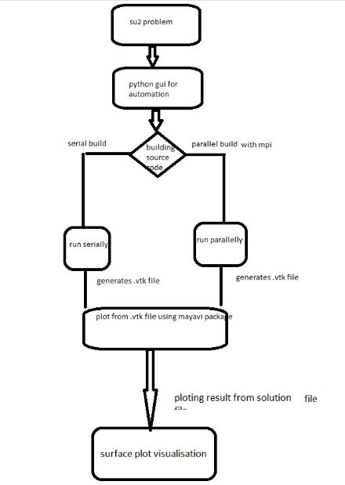
System overview

Slide 8
Building Source code
SU2 uses the GNU automake tools to configure and build the software from source in Linux
Building serially:
$ cd /path/to/your/SU2/
$ ./configure --prefix=/path/to/install/SU2
$ make
$ make install
make -j 8 install
Building parallelly:
$ cd /path/to/SU2
$ ./configure --prefix=/path/to/install/SU2 CXXFLAGS="-O3" --enable-mpi
--with-cc=/path/to/mpicc --with-cxx=/path/to/mpicxx
$ make -j 8 install

Slide 9
RUNNING SU2_CFD
Input files:
1.mesh file
The SU2 mesh format carries an extension of .su2, and the files are in a readable ASCII format. As an unstructured code, SU2 requires information about both the node locations as well as their connectivity
2.configuration file
The configuration file is a text file that contains a user’s options for a particular problem to be solved with the SU2 suite. It is specified as an input upon execution of SU2 components
The SU2 configuration file name typically carries a name of the form filename.cfg
The developers keep this file up to date with the latest options, and it serves as the first reference for the available options in SU2

Slide 10
Continued..
1.Running serially:
It is running cfd code using single core in cpu
Linux command for running cfd code
$SU2_CFD your_config_file.cfg
2.Running parallelly:
It is running parallelly using multiple cores
Which speeds up the process
Since in aerodynamics computations calculation speed Is the matter for better results
$ mpirun -np 4 SU2_CFD default.cfg
Running su2_cfd will give output file .vtk

Slide 11
Ploting from .vtk file
SU2 is capable of outputting solution files and other result files that can be visualized in a number of formats, including ParaView (.vtk)
At the end of each simulation (or at a a frequency specified by the user), SU2 will output several files that contain all of the necessary information for post-processing of results, visualization, and a restart
flow.dat or flow.vtk: full volume flow solution.
surface_flow.dat or surface_flow.vtk: flow solution along the surface of the geometry.

Slide 12
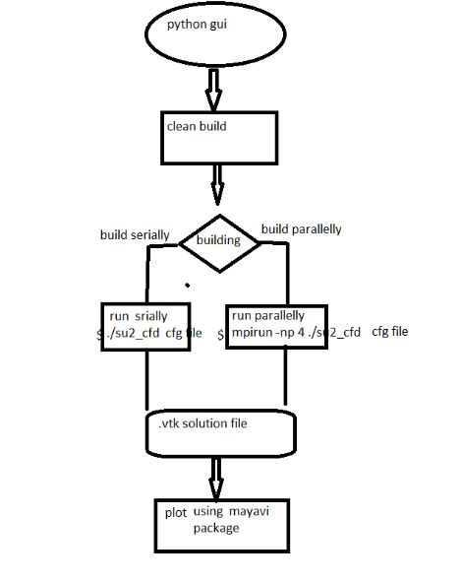
Flow graph

Slide 13
Python gui using tkinter
Gui for SU2 configuration file(problem input details)
To automate the building,execution,ploting
from configuration file and mesh file
Tkinter’s three geometry managers - pack, place and grid - are much more powerful and easy to use.
Python can also go through all of the directories and folders on your computers and read those files as well.Simple Python scripts can make short work of simple tasks that must be done to hundreds or thousands of files spread across a directory tree or your entire computer.
$os.system() command to automate the command line arguments in python.

Slide 14
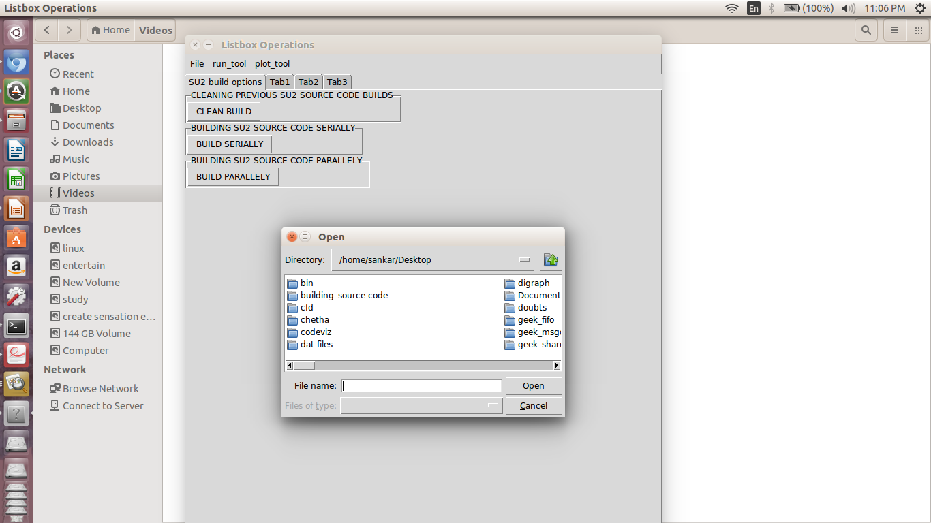
Gui screen shots

Slide 15
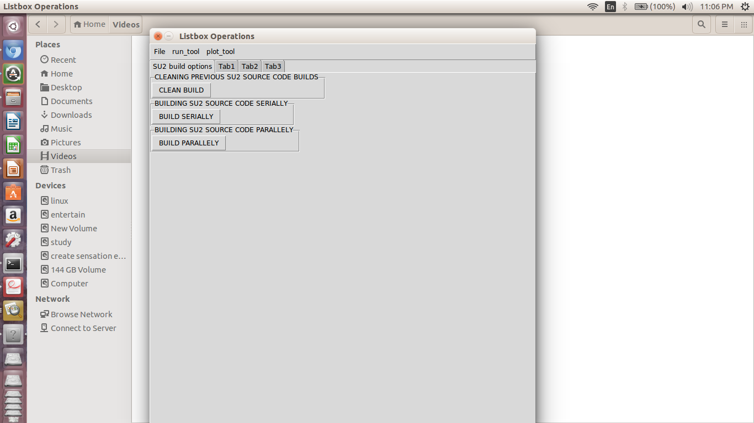

Slide 16
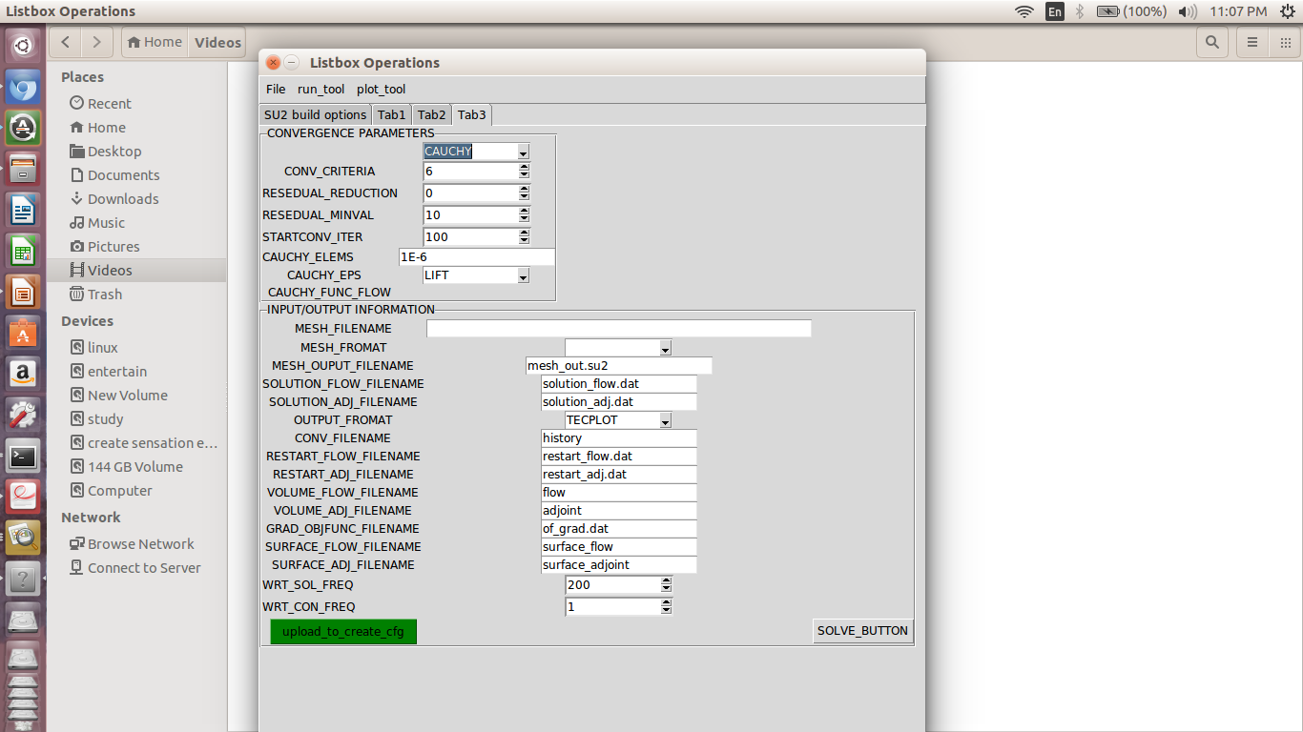

Slide 17
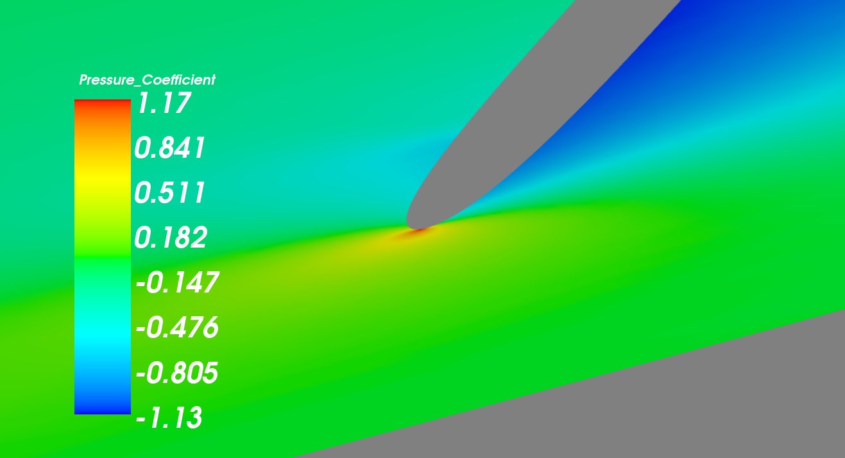

Slide 18
Conclusion and future scope
We are able to build SU2 source code both paralelly and serially through
python Gui.
And able to run it both serially and paralelly .
Finally plot the results from .vtk using mayavi library in python.All the
events were automated through gui using python automation script.
To develop a tool for performance metrics
● Latency chcek
● Throughput
● Computational delay

Slide 19
THANK YOU

